Slide 1



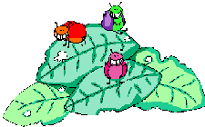

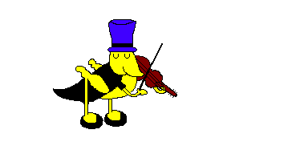
WELCOME TO OUR CLASS!
Class: 3A
Teacher: Nguyen Thi Hien
School: Ai Mo A Primary school

Slide 2


GAME
SLAP THE BOARD

Slide 3
Unit 6 Stand up!
Lesson 1 (1,2,3 - P40)

Slide 4
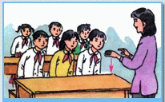
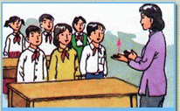
1. Vocabulary
sit down:
ngồi xuống
stand up:
đứng lên

Slide 5
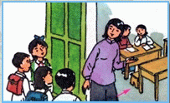
1. Vocabulary
come here:
đến đây

Slide 6
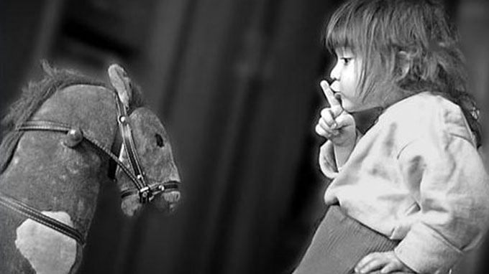
1. Vocabulary
- be quiet
= don’t talk :
Trật tự, im lặng

Slide 7
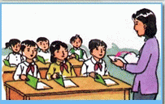
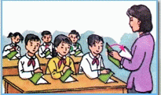
1. Vocabulary
open your book:
close your book:
mở sách ra
đóng sách lại

Slide 8
Friday, October 24th 2014
Unit 6 Stand up
Lesson 1 (1,2,3- P40)
1. Vocabulary
- sit down: ngồi xuống
- stand up: đứng lên
- be quiet = don’t talk : trật tự, im lặng
- open your book : mở sách ra
- close your book: đóng sách lại
- come here: đến đây

Slide 9
Matching
1
2
3
4
5
6
be quiet
open your book
come here
stand up
close your book
sit down

Slide 10
Friday, October 24th 2015
1. Vocabulary
- sit down: ngồi xuống
- stand up: đứng lên
- be quiet = don’t talk : trật tự, im lặng
- open your book : mở sách ra
- close your book: đóng sách lại
- come here: đến đây

Slide 11
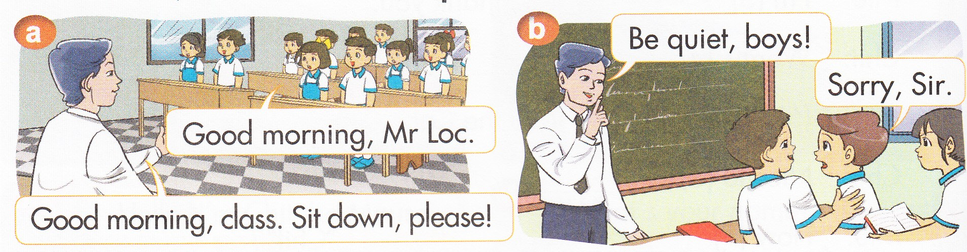
Look, listen and repeat

Slide 12
2. Model sentences
Sit down, please!
Be quiet!

Slide 13
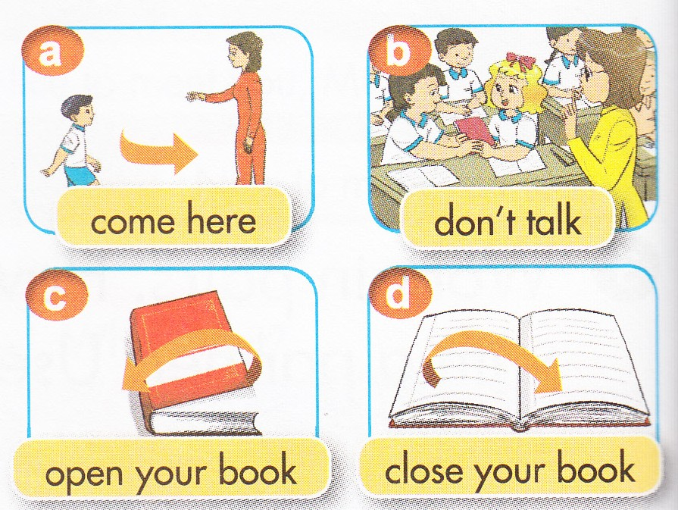
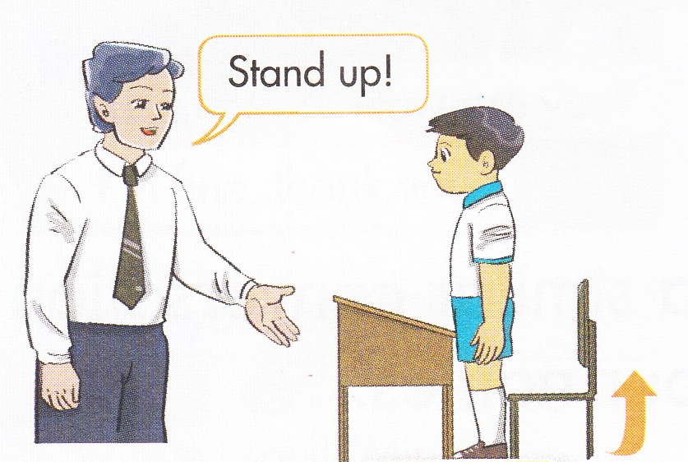
Point, say and do the action

Slide 14
Let’s talk

Slide 15

Sit down, please!
Be quiet!
Close your book, please!

Slide 16


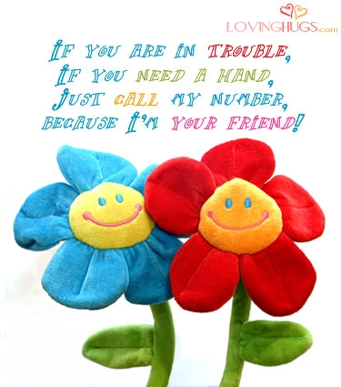
Practice with your friends.
- Learn by heart.
- Prepare unit 6.Lesson 2

Slide 17



Thank you very much
Good bye! See you again!

